Slide 1

Adult nutrition market in India
Adult Nutrition Market In India

Slide 2








Table of contents
Key Trends
Key Collaboration
Key players and drivers
Key Players Assessment
Restraints
Overview
Entry Barriers
Notes:
© Copyright PresentationGO.com – The free PowerPoint and Google Slides template library

Slide 3

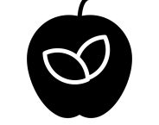


Overview
The growth of the adult nutrition market in India is expected to persist, driven by factors such as heightened awareness of health, growing disposable incomes, and government initiatives aimed at improving nutrition..
Overview
Human nutrition refers to the presence of essential components in food necessary to sustain human life and promote health. These elements are essential for the body's energy, maintenance, and growth
The body necessitates substantial quantities of macronutrients like carbohydrates, proteins, and fats, as well as minute amounts of micronutrients, including vitamins and certain trace minerals
Nutrition Market Segmentation
PRODUCT TYPE
APPLICATION
PRODUCT FORM
Carbohydrate
Vitamins
Protein & Amino Acids
Probiotics
Others
Immunity
Sports Nutrition
Energy & Weight Management
Clinical Nutrition
Others
Tablets
Capsules
Powder
Soft Gels
Liquids
Source(s)- Link1, Link2

Slide 4

Key Trends
Major trends in adult nutrition market in India includes rise of functional foods, vegan and plant based diets and immunity boosting products
1
Functional foods, which offer additional health advantages over and beyond basic nutrition, are in increasing demand due to a growing affinity towards food items that offer multiple benefits that can protect against diseases. They consist of items like protein supplements, foods fortified with vitamins and minerals, and herbal supplements.
2
The demand for weight management goods such as low-calorie snacks, meal replacement drinks, and fat burners is rising as more individuals are becoming conscious about energy and weight management.
3
A growing number of Indians are switching to vegan and plant-based diets because of concerns about animal welfare and the effects of animal agriculture on the environment. The demand for vegan protein supplements, plant-based meat substitutes, and dairy-free goods has increased as a result of this.
4
The COVID-19 pandemic has increased the significance of keeping a robust immune system, driving demand for items that do so, such as vitamin C supplements, herbal teas, and probiotics.
5
With the growth of e-commerce sites like Amazon, Flipkart, and Big Basket, consumers now have easier access to a larger selection of adult nutrition goods. As a result, there is now more brand rivalry and consumer price transparency.
Source(s)- Link1, Link2, Link3

Slide 5
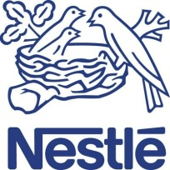
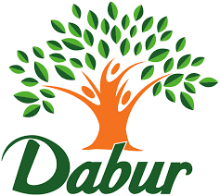
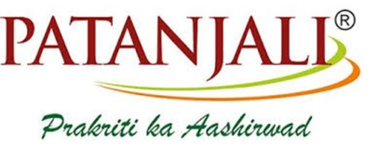
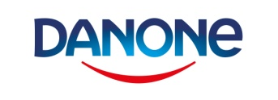
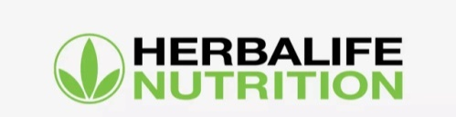

Key Players & Drivers
Market Size
Key Players
In 2024, the Indian dietary supplements market reached a value of $2.63 billion , and it is expected to experience a compound annual growth rate (CAGR) of 13.5% from 2025 to 2028
The growing recognition of the importance of incorporating essential micronutrients, vitamins, minerals, and proteins into one's diet for maintaining a healthy lifestyle is a key factor driving the expansion of the dietary supplement market in India
KEY DRIVERS
The adult nutrition market is driven by heightened consumer awareness regarding preventive healthcare, a surge in purchasing power, and a rise in the incidence of lifestyle diseases like obesity, hypertension, diabetes, malnutrition, and others
The rising awareness of the adverse effects of excessive chemical usage prompts consumers to opt for nutritional supplements, thereby fueling the growth of the nutritional supplement market
The need for energy and weight management is anticipated to rise in response to the expansion of exercise facilities, health clubs etc. along with rising youth fitness awareness
Adults are experiencing nutritional adequacies as result of their hectic schedule and changing lifestyle which lead to need of nutritional products
Increasing number of new and innovative nutritional products launches is anticipated to drive the market growth
Source(s)- Link1, Link2

Slide 6

Restraints in Adult Nutrition Market
The adult nutrition sector has a number of obstacles that call for creative solutions. Firms in the market must concentrate on educating consumers, creating products that are affordable, and carrying out comprehensive research to prove the efficacy as well as security of their products.
Negative Perception
Adults have created a negative perception due to side effects of nutritional products. Also, Indian market is overrun with counterfeit nutraceuticals, making it difficult for customers to distinguish between the real thing and the imitation
Changing Customer Preferences
Fast-changing consumer preferences for nutrition items can make it difficult for companies to stay on top of trends and be relevant.
Regulatory Challenges
The adult nutrition industry is highly regulated, and companies must stick to various guidelines along with a number of rules and regulations, which are very challenging and time-consuming.
Lack of Awareness
Many individuals do not understand the significance of good nutrition, which can result in poor dietary decisions and health problems.
High Cost
The high cost of many adult nutrition products can make them less accessible to the general public.
Source(s)- Link1, Link2, Link3

Slide 7
Entry Barriers
Due to regulations, competition, customer preferences, distribution issues, and pricing pressures, entering the adult nutrition industry in India might be difficult. Nonetheless, there is still a chance for new entrants to thrive by spotting market gaps, providing distinctive goods or formulas, and forming reliable alliances with suppliers and merchants.
The Indian nutrition market is heavily regulated and is subject to a number of legal obligations making it difficult for new competitors to enter the market
To set up reliable logistics and distribution system is a tough ask as the Indian Nutrition sector is extremely fragmented.
Established firms have a loyal client base, and well-established distribution networks, making it difficult for new competitors to compete.
Cultural and dietary traditions of the Indian population impacts the demand for nutritious items as many individuals are hesitant to change their eating patterns.
Many Indian consumers are unwilling to pay a premium price for nutritional items, which can make it difficult for companies to set competitive prices for their goods.
Regulatory Barriers
01
Distribution and Logistics
02
03
Established competitors
04
Cultural Barriers
05
Price Sensitivity
Source(s)- Link1, Link2, Link3, Link4

Slide 8



Key Player Assessment
Company Overview
Company Overview
Company Overview
Amway India, a wholly owned subsidiary of Amway was established in 1995, that has offerings in segments like Nutrition, personal care, home care, skin care and consumer durables.
Business Models- Nutrition, Beauty, Home & living, Personal care
Revenue- INR 500 Crore
Geographical Presence- Presence in over 100 countries & territories
Established in 1995, Herbalife is nutrition company that offers weight management, energy & fitness and other nutritional products
Business Models- Vritilife Ayurvedic Nutrition, Weight Management, Energy & Fitness, Targeted Nutrition
Revenue- Over INR 500 Crore
Geographical Presence- North America, Latin America EMEA, Asia Pacific
Dabur India Limited headquartered in Ghaziabad, has its portfolio established in Ayurvedic products and Natural Health Care. Company that has a portfolio of over 250 Herbal and Ayurvedic products.
Business Models- Hair Care, Oral Care, Health Care, Skin Care, Home Care and Food &Beverages
Revenue- INR 2,783 Crore
Geographical Presence- India
Source(s)- Link1, Amway, Dabur, Herbalife

Slide 9




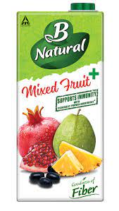
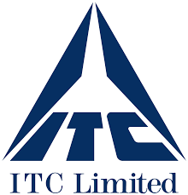
Key Collaborations
The Board of Control for Cricket in India (BCCI) has signed Herbalife Nutrition Limited as its partner for the Tata Indian Premier League (IPL) for its season, 2024. This will help in its expansion in tier 2 and tier 3 cities in India. Herbalife also partnered with Magic Bus India Foundation to support the development of 3,000 children in Bengaluru, Chennai and Pune through sports and education. The company has also announced partnership with international women’s cricket sensation, Smriti Mandhana as a nutrition sponsor.
Indian Oil Corporation has partnered with Dabur as retail business partners to assist Dabur in selling the its whole line of products directly to cooking gas customers through their network of delivery employees. This partnership will provide direct access to around 14 crore LPG consumer households. The company also entered into the health food drink market in 2021 with the launch "Dabur Vita," claiming to have a combination of more than 30 herbs, including Ashwagandha, Giloy, and Brahmi, which is scientifically backed and helps improve immunity in children
ITC's B Natural and Amway India formed a strategic alliance in the year 2020 to launch an immunity-promoting fruit beverage line B Natural+ in order to respond to customers' growing concerns about health and hygiene. Given the current health crisis induced by the Covid-19 pandemic, ensuring the family's immunity has become a top priority for consumers. Amway India is anticipated to expand the market penetration of these immunity-based products in India as part of the cooperation.
Sources:- Link1, Link2, Link3

